Slide 1



Slide 2
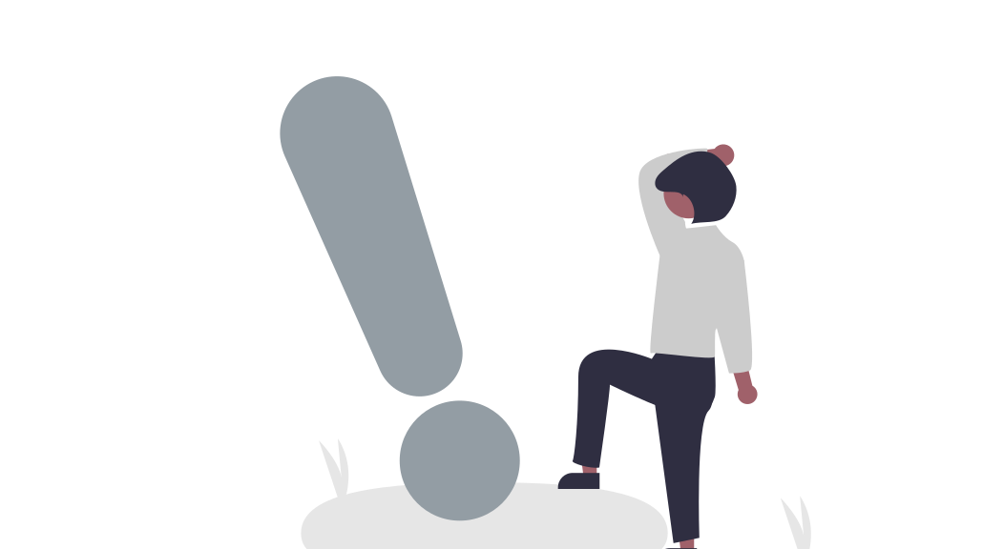



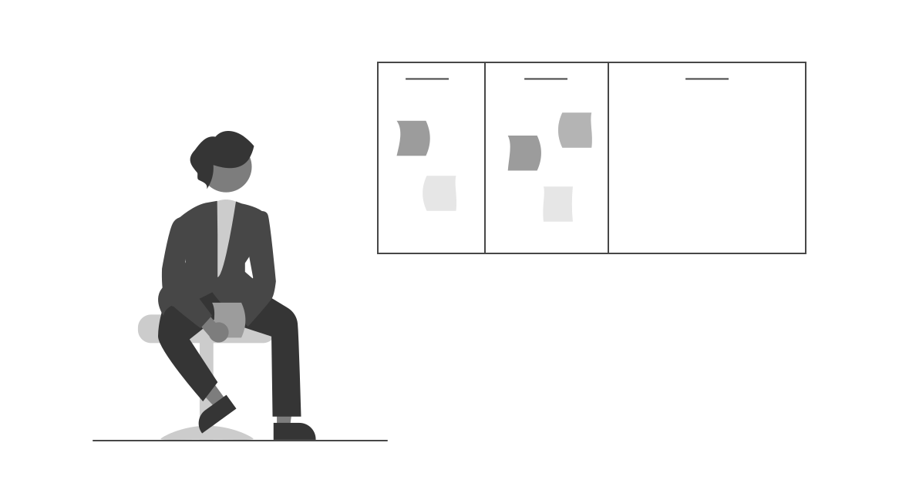

The making of a new chatbot library…
Challenges I faced with existing open-sourced chatbot libraries…
… and this motivated me to create:
Outdated
React ChatBotify
Little flexibility
A modern React library for creating a flexible and extensible chatbot
Complex

Slide 3
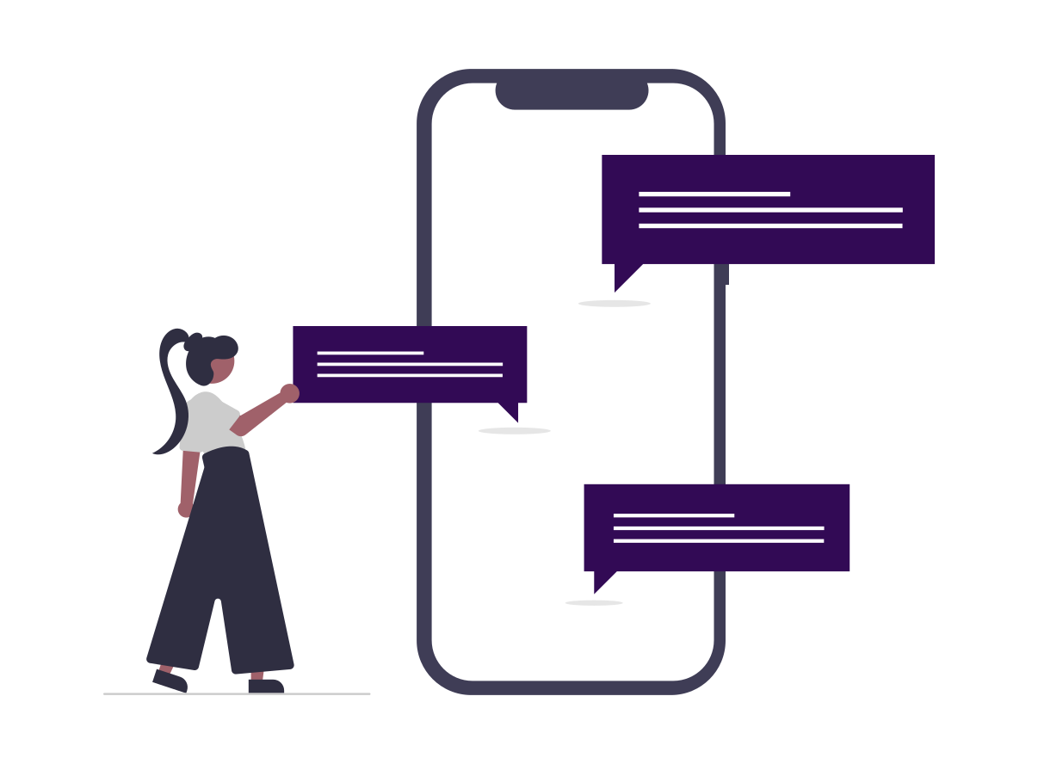


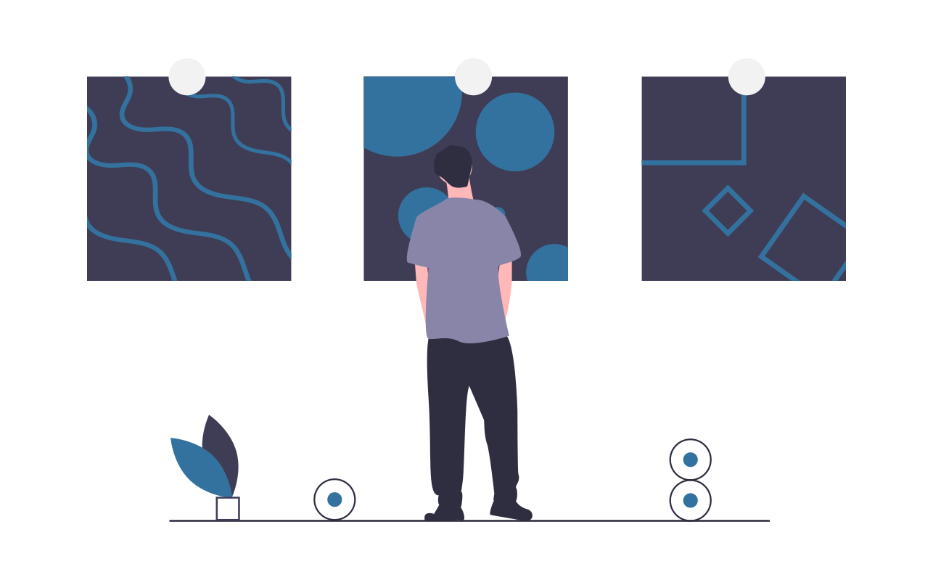
Design Architecture
Flows
Themes
Styles
Settings
Defines conversation flows between chatbots & users
A set meal for styles and settings
Defines appearance of the chatbot
Defines functionalities & features of the chatbot

Slide 4


Design Architecture: Flows
Flow
Block
Attributes
Params
Pre-processes start conversation block
Post-processing of current block
Parse post-process attributes
Retrieve params for dynamic attributes
Sends message
Retrieves current conversation block
Paths to next block
Pre-processing of new block
Parse pre-process attributes
Retrieve params for dynamic attributes
Example of a conversation block
const flow = {
start: {
message: ”Who are you?",
path: "end"
},
end: {
message: (params) => `Hi ${params.userInput}!`,
chatDisabled: true
}
}

Slide 5
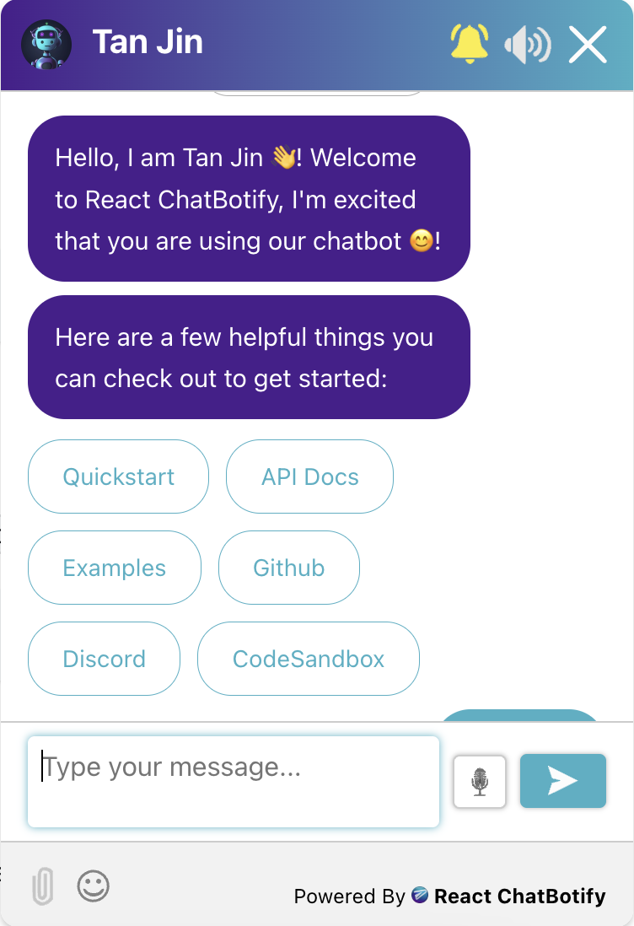
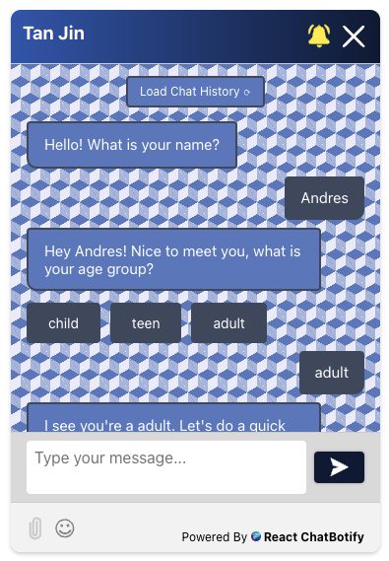
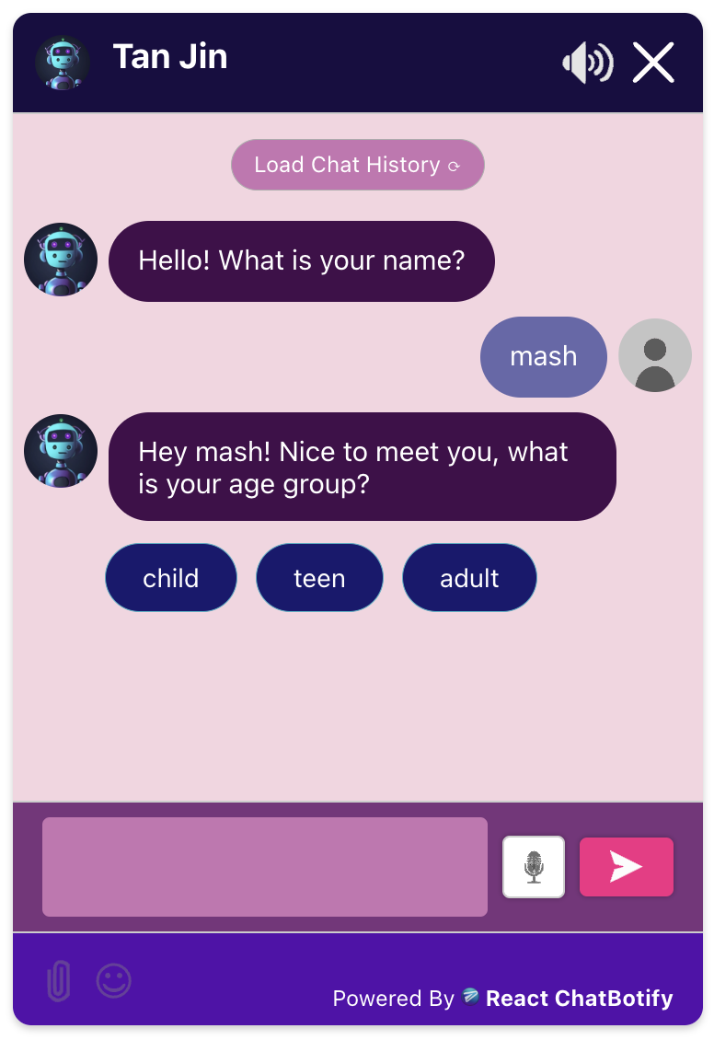
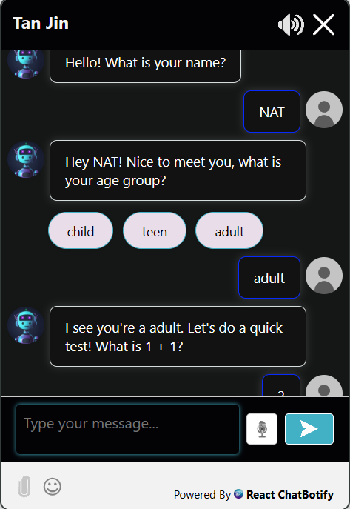
Design Architecture: Themes

Slide 6




Design Architecture: Themes
Chatbot
Themes
Retro
Styles
Settings
Dark
Styles
Settings

Slide 7


React ChatBotify
A modern React library for creating a flexible and extensible chatbot
CityJS Singapore 2024 | Tan Jin

Slide 8
Notes
This slide deck was presented as a 15 minutes lightning talk @CityJS Singapore on 24th July 2024
Live examples covered in the talk can be found here: https://react-chatbotify.com
Project is open sourced at https://github.com/tjtanjin/react-chatbotify

